Slide 1
Multithreading Programming

Slide 2
Topics
Multithreading versus asynchronous programming
Multithreading in .NET Core
Threads in .NET Core
Thread synchronization
Lock
Monitor
Interlocked

Slide 3
Multithreading versus asynchronous programming
Multithreading refers to the practice of executing multiple threads at the same time to execute multiple operations or tasks in parallel. There could be one main thread and several background threads, usually known as worker threads, running in parallel at the same time, executing multiple tasks concurrently, whereas both synchronous and asynchronous operations can run on a single-threaded or a multithreaded environment.
In asynchronous programming, it is not always the case that each asynchronous operation will be running on a new thread. Async/Await is a good example of a situation where there is no additional thread created. The async operation is executed in the current synchronization context of the main thread and queues the asynchronous operation executed in the allocated time slice.

Slide 4
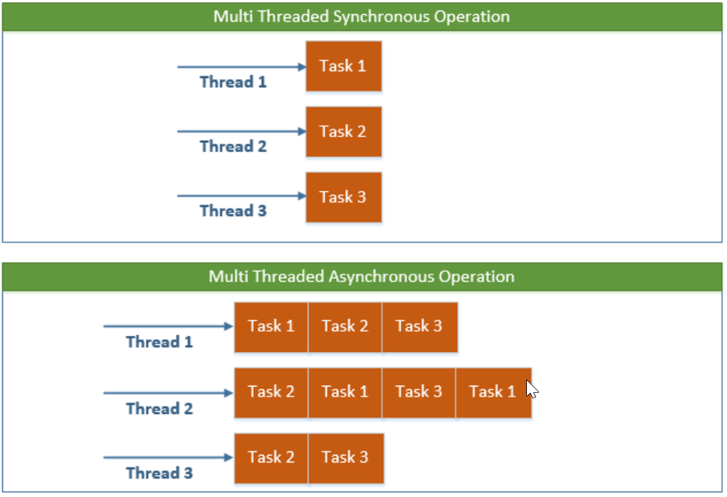
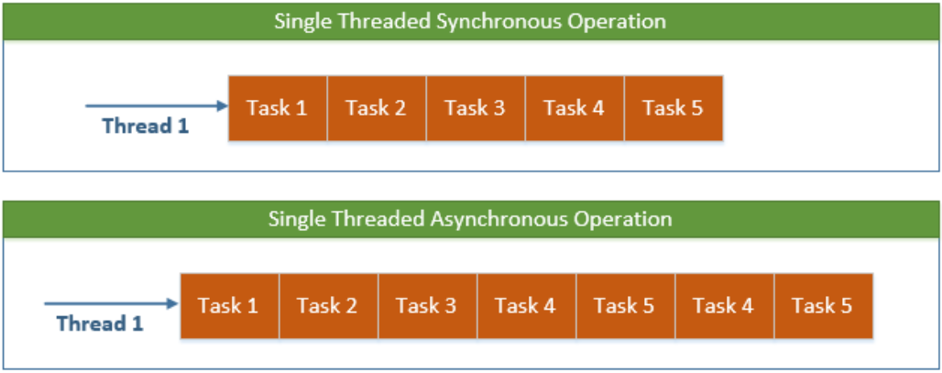

Slide 5
Multithreading in .NET Core
Here are some examples where multithreading is a good fit:
I/O operations
Running long-running background tasks
Database operations
Communicating over a network

Slide 6
Multithreading caveats
Although there are many benefits to multithreading, there are some caveats that need to be thoroughly addressed when writing multithreaded applications. If the machine is a single or two-core machine and the application is creating lots of threads, the context switching between these threads will slow the performance:
As far as the developer experience is concerned, debugging and testing are two other issues that are challenging for developers when creating a multithreaded application.

Slide 7
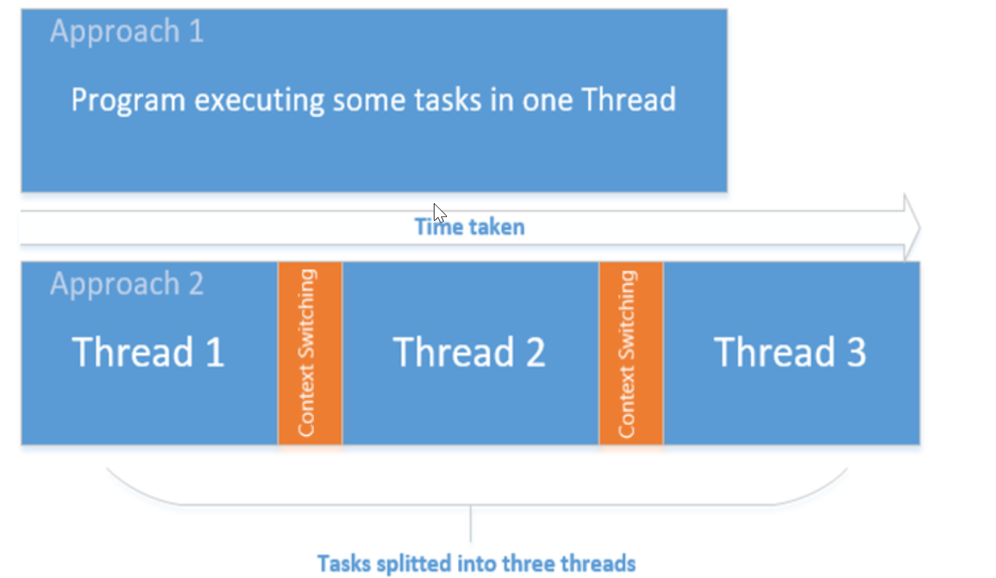
The preceding diagram depicts the program running on a single-processor machine. The first task executes synchronously, and runs comparatively faster than the three threads running on the single processor.

Slide 8
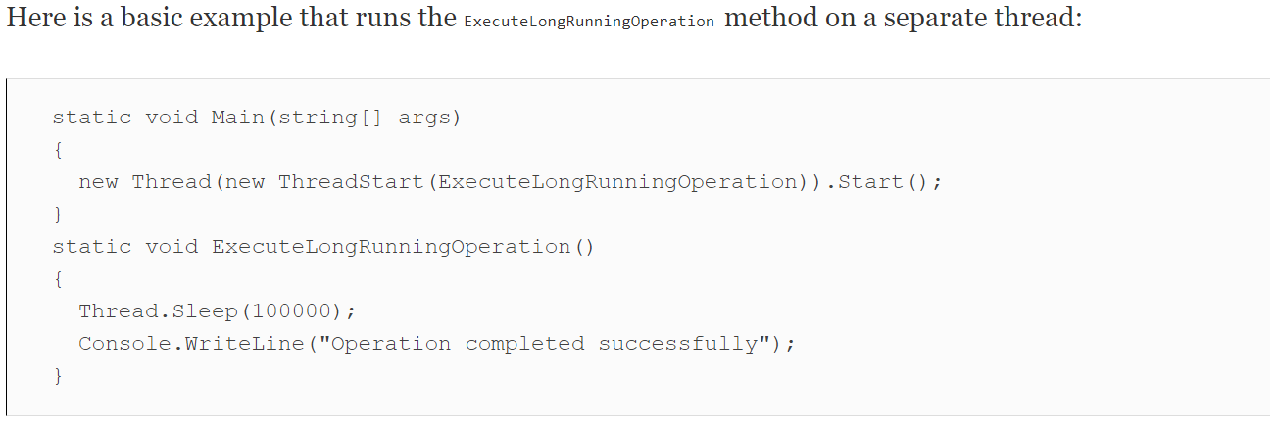
Creating threads in .NET Core
In .NET Core, the threading API is the same as that used in the full .NET Framework version. A new thread can be created by creating a Thread class object and passing the ThreadStart or ParameterizedThreadStart delegate as a parameter. ThreadStart and ParameterizedThreadStart wrap a method that is invoked when the new thread is started. ParameterizedThreadStart is used for method containing parameters.

Slide 9
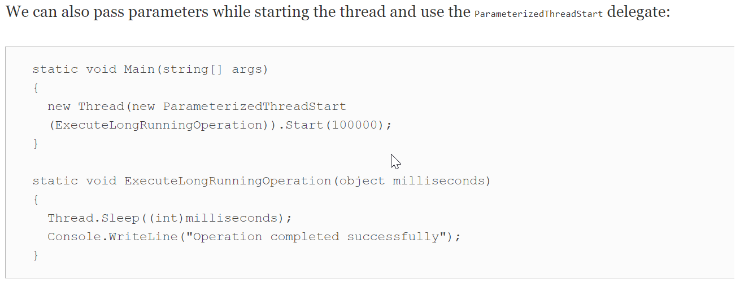

Slide 10
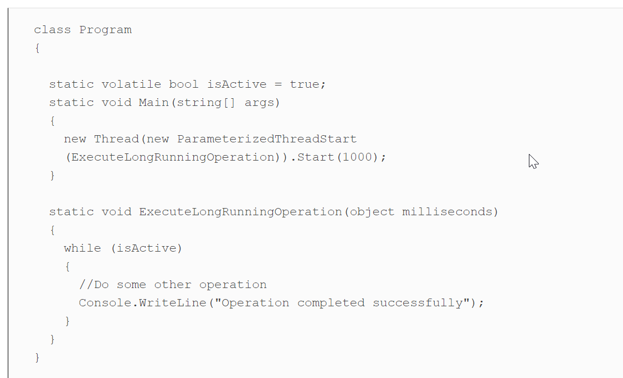
Thread lifetime
The lifetime of the thread depends on the method executing within that thread. Once the method is executed, CLR de-allocates the memory taken by the thread and disposes of. On the other hand, the thread can also be disposed of explicitly by calling the Interrupt or Abort methods.Another very important factor to consider is exceptions. If the exceptions are not properly handled within a thread, they are propagated to the calling method and so on until they reach the root method in the call stack. When it reaches this point, CLR will shut down the thread if it is not handled.For continuous or long-running threads, the shutdown process should be properly defined. One of the best approaches to smoothly shut down the thread is by using a volatile bool variable:

Slide 11
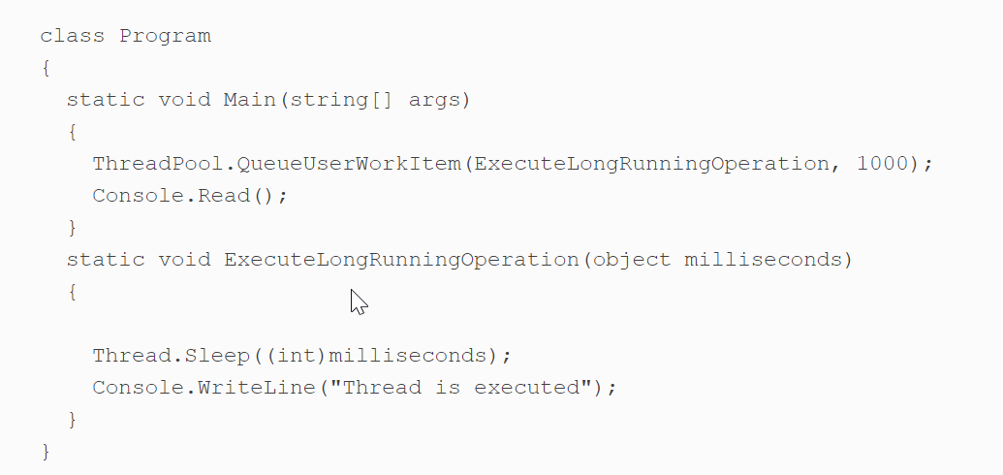
The thread pool in .NET
CLR provides a separate thread pool that contains the list of threads to be used to execute tasks asynchronously. Each process has its own specific thread pool. CLR adds and removes threads in or from the thread pool.To run a thread using ThreadPool, we can use ThreadPool.QueueUserWorkItem, as shown in the following code:
QueueUserWorkItem queues the task to be executed by the CLR in a thread that is available in the thread pool. The task queues are maintained in First In, First Out (FIFO) order. However, depending on the thread's availability and the task job itself, the task completion may be delayed.

Slide 12
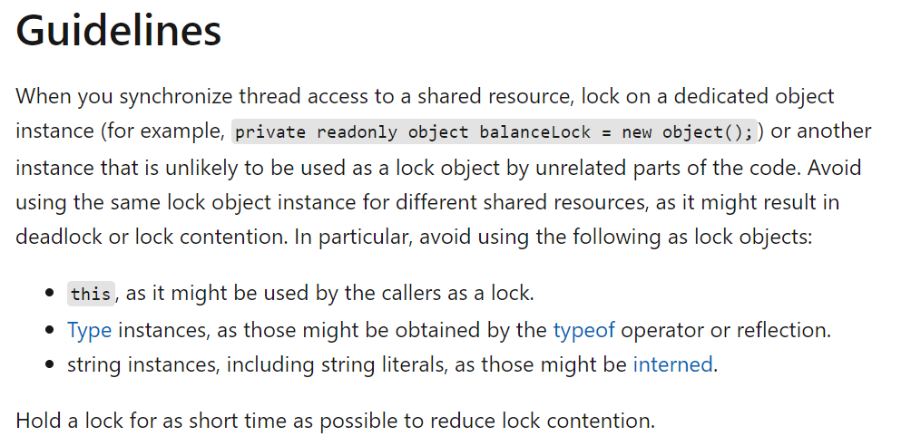
Thread synchronization - Lock
In multithreaded applications, we have shared resources that are accessible by multiple threads executing simultaneously. The area where the resources are shared across multiple threads is known as the critical section. To protect these resources and provide thread-safe access, there are certain techniques that we will discuss in this section.

Slide 13
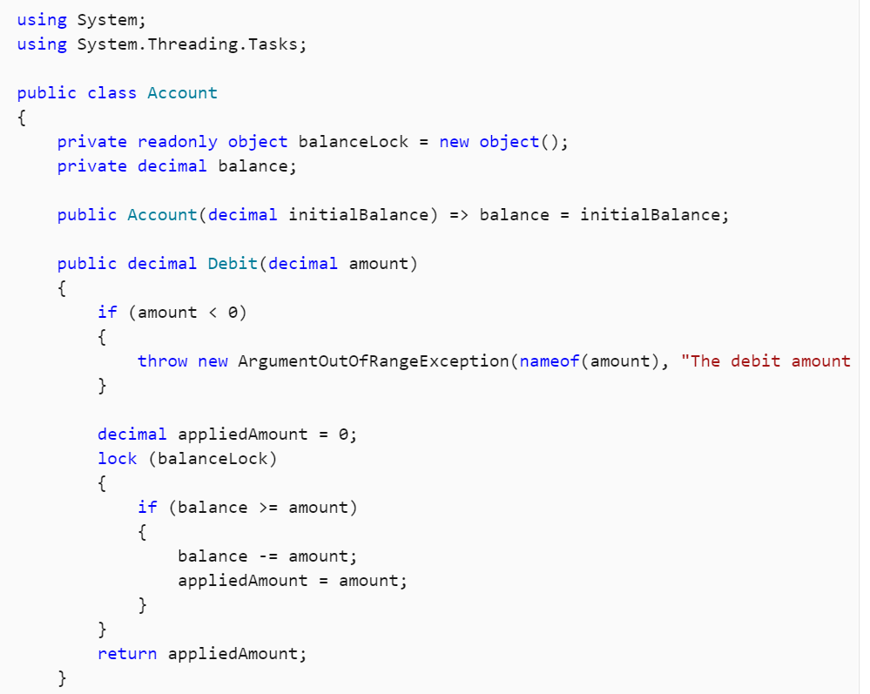

Slide 14
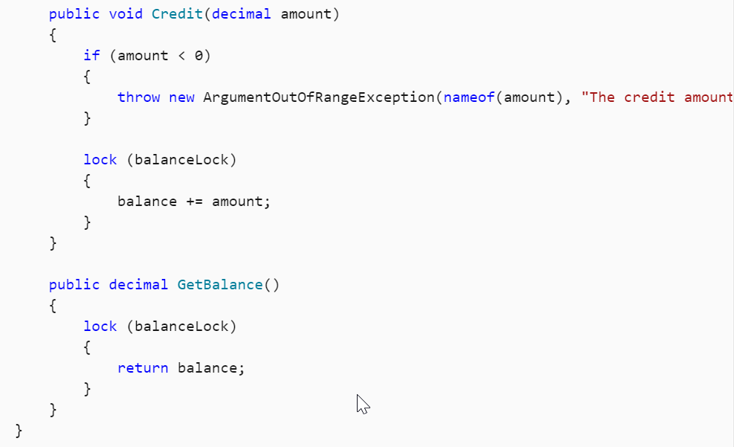

Slide 15
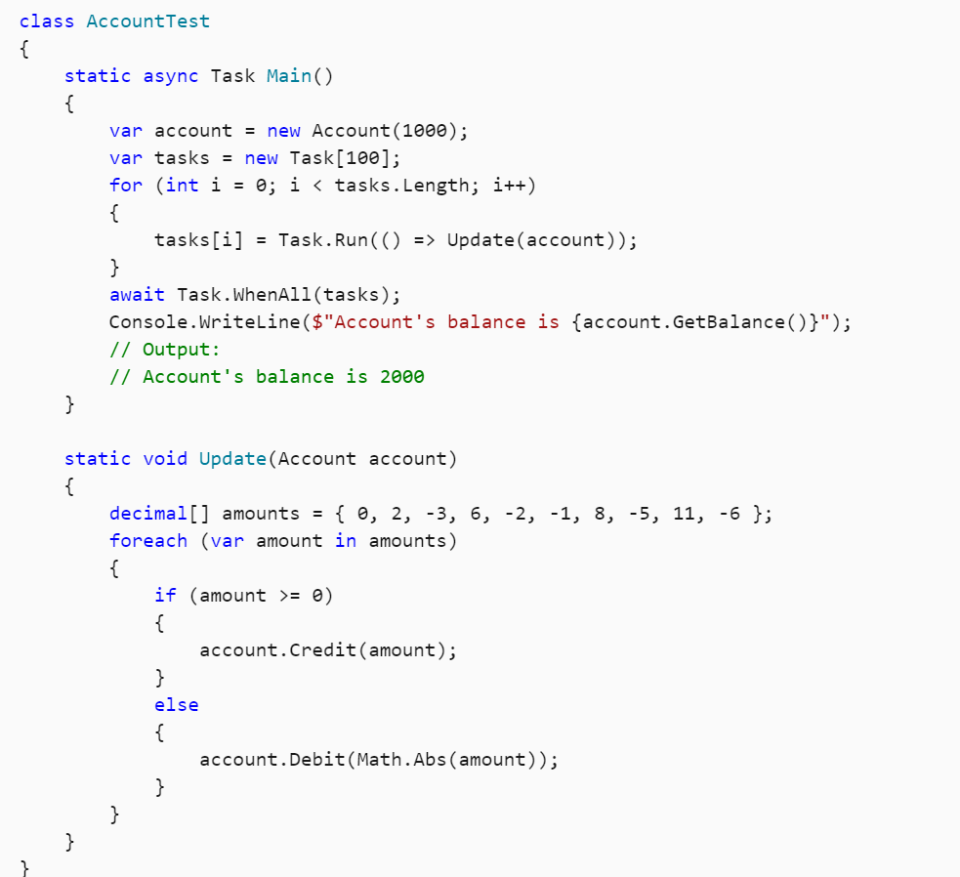

Slide 16
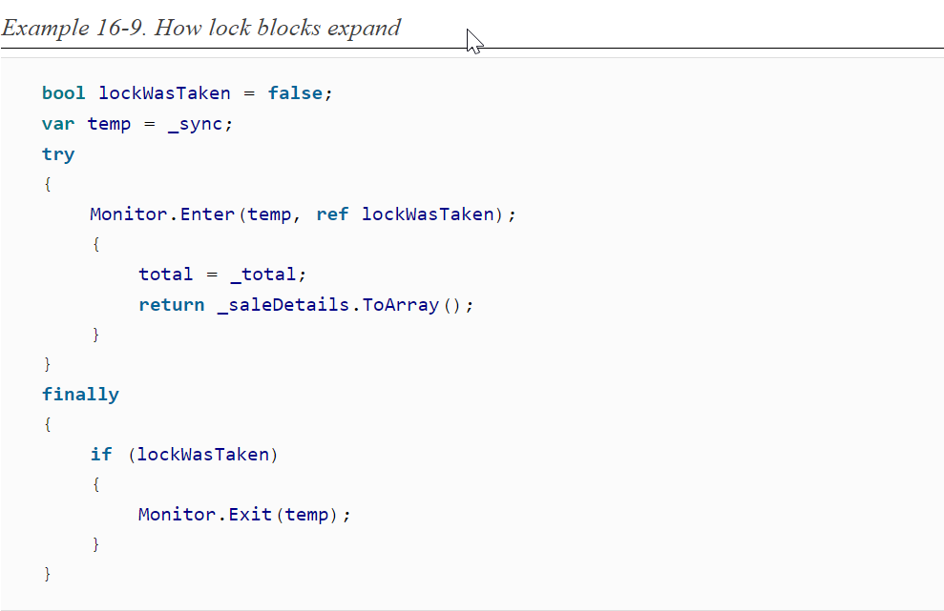
Monitors
The first option to consider for synchronizing multithreaded use of shared state is the Monitor class. This is popular because it is efficient, it offers a straightforward model, and C# provides direct language support, making it very easy to use
lock keyword (which in turn uses the Monitor class) any time it either reads or modifies its internal state. This ensures that only one thread will be accessing that state at any one time
Each lock block turns into code that does three things: first, it calls Monitor.Enter, passing the argument you provided to lock. Then it attempts to run the code in the block. Finally, it will usually call Monitor.Exit once the block finishes.

Slide 17
If a thread calls Pulse, this enables one thread waiting in Wait to wake up. Calling PulseAll enables all of the threads waiting on that object’s monitor to run
Monitor.Enter is the API that does the work of discovering whether some other thread already has the lock, and if so, making the current thread wait. If this returns at all, it normally succeeds
Monitor.Exit tells the CLR that we no longer need exclusive access to whatever resources we’re synchronizing access to, and if any other threads are waiting inside Monitor.Enter for the object in question, this will enable one of them to proceed.
WAITING AND NOTIFICATION
It provides a way for threads to sit and wait for a notification from some other thread. If a thread has acquired the monitor for a particular object, it can call Monitor.Wait, passing in that object. This has two effects: it releases the monitor and causes the thread to block. It will block until some other thread calls Monitor.Pulse or PulseAll for the same object
If a thread calls Pulse, this enables one thread waiting in Wait to wake up. Calling PulseAll enables all of the threads waiting on that object’s monitor to run
uses Wait and Pulse to provide a wrapper around a Queue<T> that causes the thread that retrieves items from the queue to wait if the queue is empty. (This is for illustration only—if you want this sort of queue, you don’t have to write your own. Use the built-in BlockingCollection<T>, or the types in System.Threading.Channels.)

Slide 18
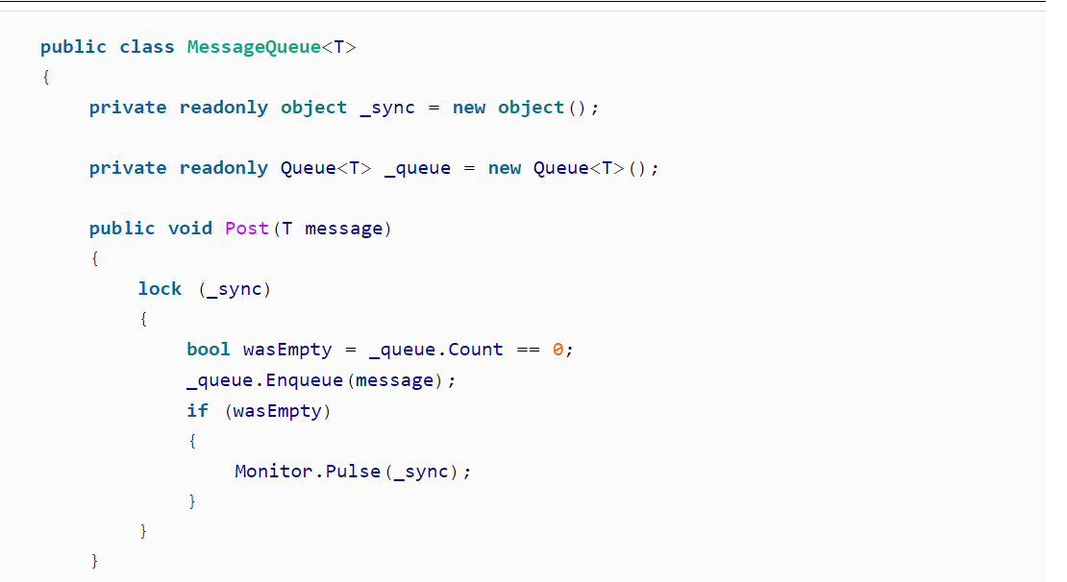


Slide 19
Interlocked
It supports concurrent access to shared data, but it is not a synchronization primitive. Instead, it defines static methods that provide atomic forms of various simple operations. it provides Increment, Decrement, and Add methods, with overloads supporting int and long values.
Interlocked also offers various methods for swapping values. The Exchange method takes two arguments: a reference to a value and a value. This returns the value currently in the location referred to by the first argument, and also overwrites that location with the value supplied as a second argument, and it performs these two steps as a single atomic operation. There are overloads supporting int, long, object, float, double, and a type called IntPtr, which represents an unmanaged pointer. There is also a generic Exchange<T>, where T can be any reference type.
There is also support for conditional exchange, with the CompareExchange method. This takes three values—as with Exchange, it takes a reference to some variable you wish to modify, and the value you want to replace it with, but it also takes a third argument: the value you think is already in the storage location. If the value in the storage location does not match the expected value, this method will not change the storage location. (It still returns whatever value was in that storage location, whether it modifies it or not.)
The downside of interlocked operations is that the atomicity applies only to extremely simple operations. It’s very hard to build more complex logic in a way that works correctly in a multithreaded environment using just Interlocked

